Slide 1
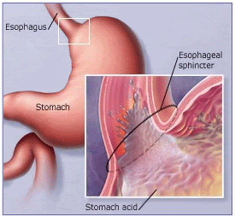
GORD, Barrett's and Hiatus Hernia
P A Sufi
Consultant General Surgeon
Bariatric and Upper GI Surgery

Slide 2
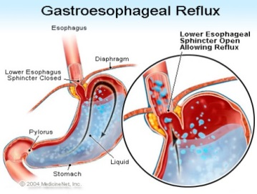
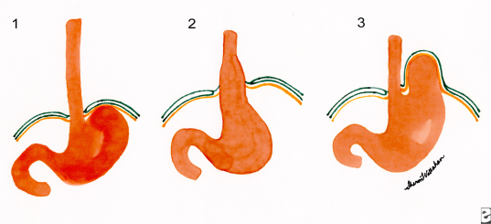
Episodic Heartburn vs. GORD vs. Hiatus Hernia
Episodic Heartburn – Heartburn symptoms of insufficient frequency or severity to be perceived as troublesome by the patient, in the absence of oesophageal injury.
  As many as 60% people in the UK have experienced symptoms of heartburn at some time – the incidence rising with age
GORD (GERD) – condition which develops when the reflux of stomach contents causes troublesome symptoms and/or complications. ^{Montreal Consensus} Symptoms are considered “troublesome” if they adversely affect an individual’s well being.
  Up to 25% of the population have GORD Gastro-oesophageal reflux disease BMJ Clinical Evidence 2006:15:1-3
  About 50% with frequent reflux symptoms in the community seek care ^{Rates of endoscopy……}
  Only 1:5 will have an OGD ^{Rates of endoscopy……}
  1:10 will consult a gastroenterologist ^{Rates of endoscopy……} and
  Only 30-70% will have oesophageal mucosal abnormalities ^{An Evidence-Based Approach…}
Hiatus hernia – when a portion of the stomach prolapses through the diaphragmatic oesophageal hiatus.
  Not all hiatus hernia patients have heartburn and not all heartburn patients have hiatus hernia. ^{Dyspepsia: NICE CG17: 2004}

Slide 3
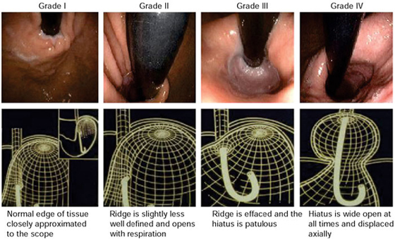
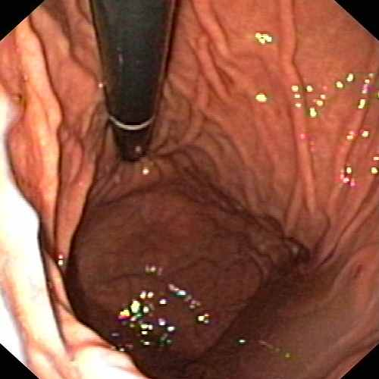
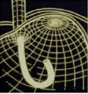
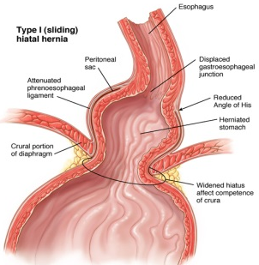
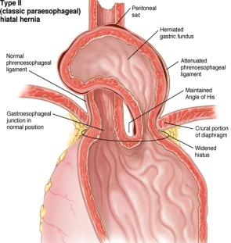
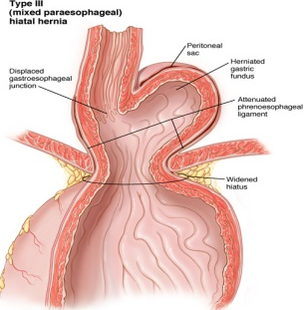
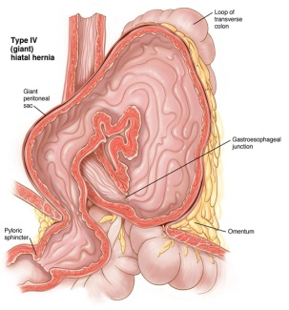

Hiatus Hernia
Type I hernias are sliding hiatal hernias, where the gastroesophageal junction migrates above the diaphragm. The stomach remains in its usual longitudinal alignment and the fundus remains below the gastroesophageal junction.
Type II hernias are pure paraoesophageal hernias (PEH); the gastroesophageal junction remains in its normal anatomic position but a portion of the fundus herniates through the diaphragmatic hiatus adjacent to the oesophagus.
Type III hernias are a combination of Types I and II, with both the gastroesophageal junction and the fundus herniating through the hiatus. The fundus lies above the gastroesophageal junction.
Type IV hiatal hernias are characterized by the presence of a structure other than stomach, such as the omentum, colon or small bowel within the hernia sac.
SAGES Guidelines for Management of Hiatal Hernia 2013

Slide 4

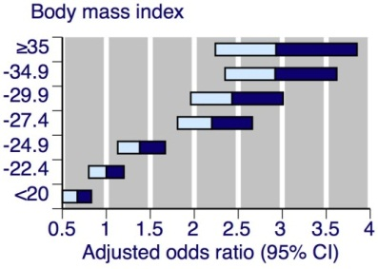



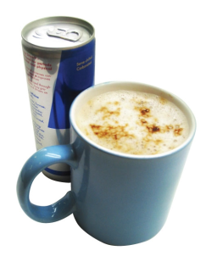

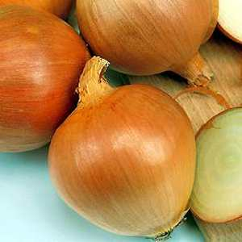
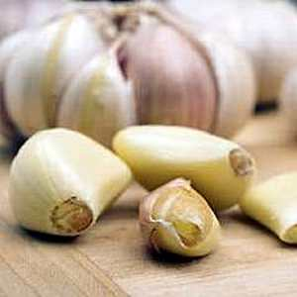


Causes of GORD
Unknown
Predisposing conditions –
  Hiatal hernia
  Obesity ^{BMI and Symptoms..}
  Pregnancy
  Smoking
  Certain food e.g. citrus, chocolate, caffeine, alcohol, fatty and fried food, garlic, onions, mint flavouring, spicy food, tomato-based foods e.g. spaghetti sauce, salsa, chilli, pizza etc. Reflux-inducing dietary factors………..
  Pathophysiologic mechanisms – ^{An Evidence-Based Approach…}
  LOS dysfunction
  Prolonged oesophageal clearance
  Diminished saliva and impaired mucosal resistance
  Delayed gastric emptying
http://www.medicine.ox.ac.uk/bandolier/band160/b160-3.html

Slide 5
GORD Syndromes
GORD Syndromes are divided as
Oesophageal syndromes
  Symptomatic syndromes
    Typical Reflux Syndrome (troublesome heartburn and or regurgitation) and
    Reflux Chest Pain Syndrome
  Syndromes with injury
    Reflux Oesophagitis
    Reflux Stricture
    Barrett’s Oesophagus and
    Oesophageal Adenocarcinoma
Extra oesophageal syndromes
  Reflux associated cough
  Laryngitis
  Asthma and
  Dental erosions
Guideline for the Treatment of Gastroesophageal Reflux Disease in Adult: Toward Optimized Practice (TOP) Program, Alberta, 2009

Slide 6


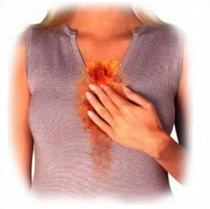
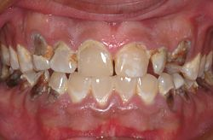

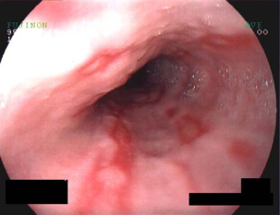


Signs and Symptoms
Oesophageal
Extra-oesophageal
Heartburn
Chest pain
Globus hystericus
Water brash
Regurgitation (food/liquid)
Sore throat
Hoarseness
Frequent clearing of throat
Loss of dental enamel
Cough, Asthma
Aspiration pneumonia
Williams DB, Schade RR. Gastroesophageal reflux disease. In: DiPiro et al. Pharmacotherapy: A Pathophysiologic Approach. 6th ed. New York, NY: McGraw-Hill; 2005: 613-628

Slide 7
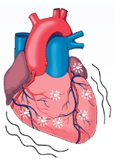
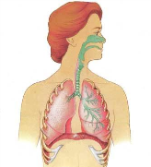
GORD - Alarm Features
Indications for further investigation
Other indications for further investigation
Dysphagia (solid food, progressive)
Odynophagia
GI bleeding/anaemia
Weight loss
Persistent vomiting
GORD symptoms that could be cardiac in origin.
Respiratory symptoms secondary to reflux
Consider if failure to respond to 8 weeks of medical therapy (some may take 16 weeks to respond)
Armstrong D, Marshall J, Chiba N, et al. Canadian Consensus Conference on the 1. Management of Gastroesophageal Reflux Disease in Adults: Update 2004. Canadian Journal of Gastroenterology, Jan 2005; 19(1).

Slide 8
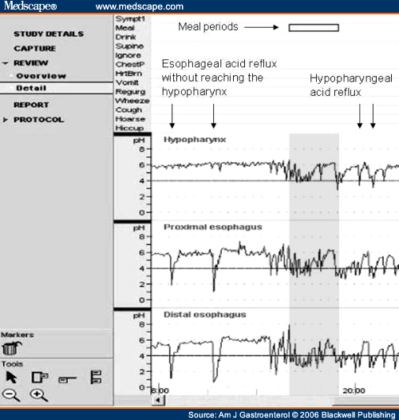
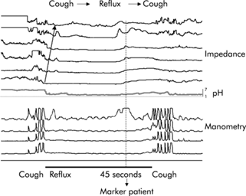
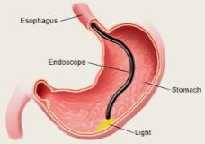
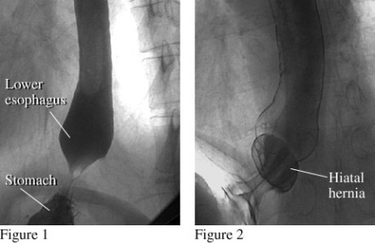
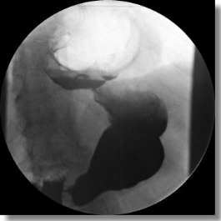
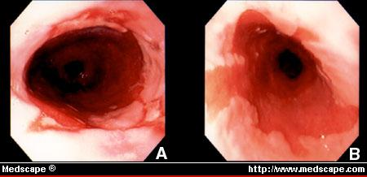
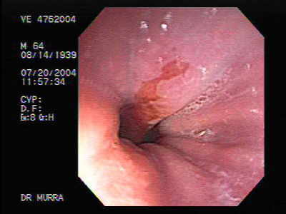
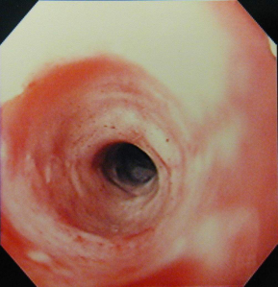
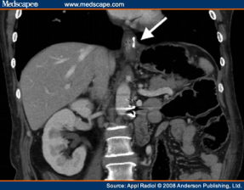
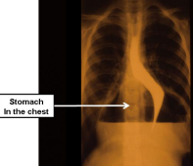
GORD / GERD Diagnosis
  PPI response test ^{Omeprazole Test}
  Investigations: ^{An Evidence-Based Approach…}
    OGD
    pH and Manometry
    Barium swallow
    CT abdomen
    Gastric emptying
  Diagnosis can be confirmed if at least 1 of the following conditions exists (Grade A): ^{Guidelines for Surgical…}
    a mucosal break seen on endoscopy in a patient with typical symptoms
    Barrett’s oesophagus on biopsy
    A peptic stricture in the absence of malignancy
    +ve pH–metry
  Guidelines for Surgical Treatment of GERD - SAGES: February 2010

Slide 9
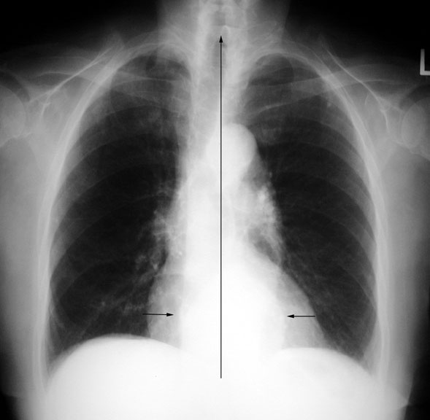
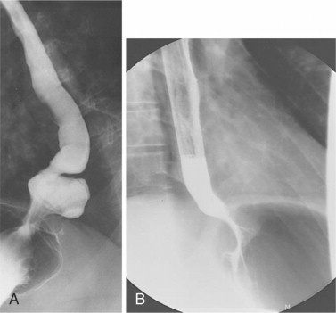
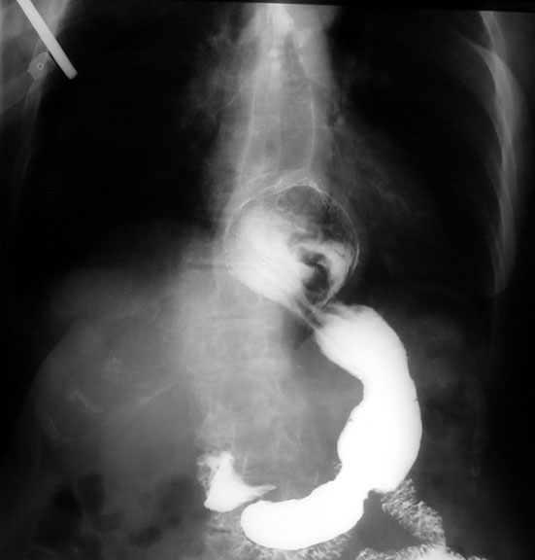
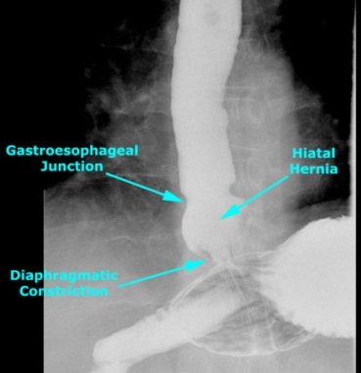
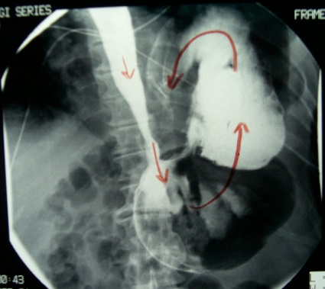
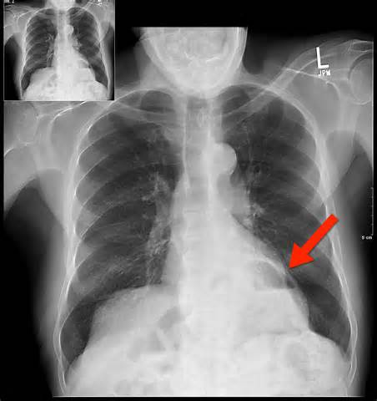
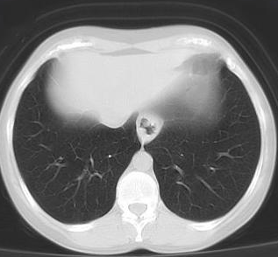
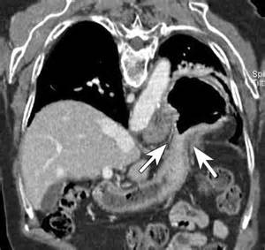
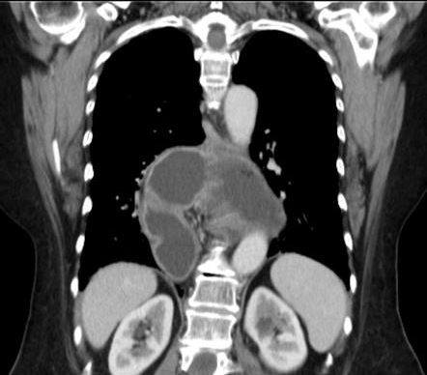
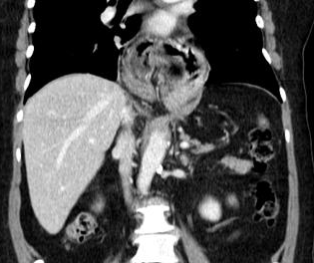
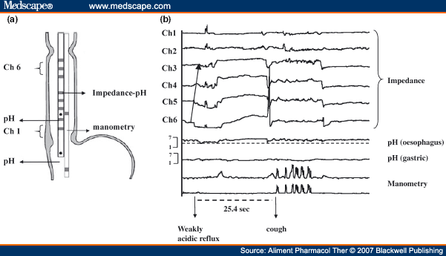
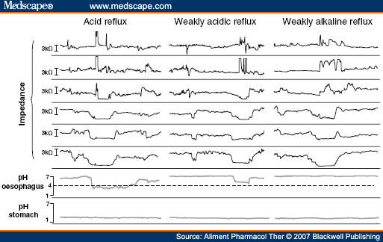
Imaging & Oesophageal Physiology

Slide 10
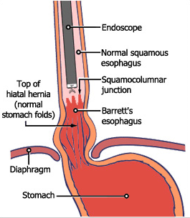
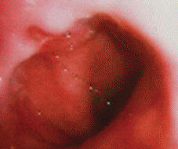
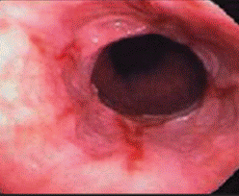
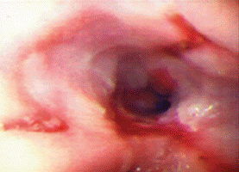
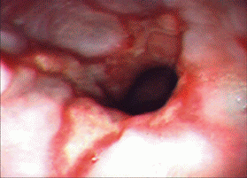
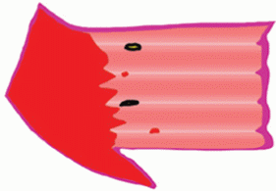
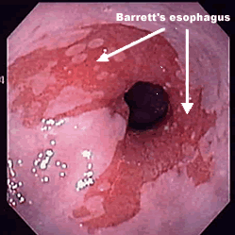
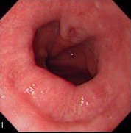
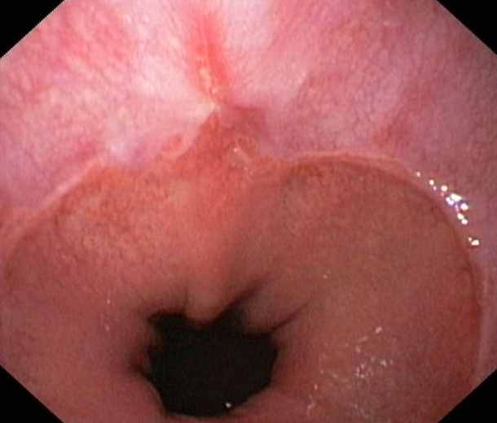




Oesophagitis
LA Grade A B C D
Single fold <5mm Single fold >5mm Bridge folds <75% circ. Bridge folds >75% circ.
SM Grade I I II III IV V
Single erosion, any length Multiple,non-circ.erosions Circum. erosion Ulceration & stricture Barrett's
BSG guidelines for the diagnosis and management of Barrett’s Columnar-lined oesophagus (CLO) 3 August 2005

Slide 11




Barrett’s Oesophagus or Columnar-Lined Oesophagus[CLO]
Macroscopically visible replacement of any portion of the normal squamous lining by metaplastic columnar epithelium.
The median incidence of CLO in 10 studies is 1.17%. It occurs in approximately 12% of those endoscoped for symptoms of GORD and 36% of those with endoscopic oesophagitis. This equates to approximately 30 new cases of CLO per year in a catchment population of 250,000.
The mean age of endoscopically diagnosed CLO is 62 years - 65% of cases occur in males, the greatest incidence being between 50 and 70 years.
Dysplasia develops in around 5% of patients with CLO. In those developing low-grade dysplasia, 10–50% may progress to high-grade dysplasia and adenocarcinoma over 2–5 years.
Clinical risk factors for progression to adenocarcinoma include
  male gender
  age > 45years
  extended segment (>8cm) disease
  duration of reflux history
  early age of onset of GORD
  duodeno-gastrooesophageal reflux
  mucosal damage (ulceration and stricture) and
  family history (uncommonly)
BSG guidelines for the diagnosis and management of Barrett’s Columnar-lined oesophagus (CLO) 3 August 2005

Slide 12





Barrett’s Oesophagus or Columnar-Lined Oesophagus[CLO]
Q. Do you always see dysplasia in Barrett’s oesophagus?
A. No, you don’t always see dysplasia. You worry about it, but most of the time you don’t see it. What you do always see is metaplasia (a replacement of one cell type with another) - the epithelium of the distal oesophagus changes from squamous to intestinal-like columnar epithelium.
BSG guidelines for the diagnosis and management of Barrett’s Columnar-lined oesophagus (CLO) 3 August 2005

Slide 13










Non-surgical Management of GORD
Lifestyle changes:
    Stop smoking
    Lose weight, if obese
    Avoid predisposing food
    Raise head end of bed
    Avoid lying down after meals
Medication
    Antacids
    Foaming agents
    H2-receptor antagonist
    PPI
    Prokinetics

Slide 14














Food to Avoid

Slide 15
AGA Medical Position 2008
PPI therapy should be recommended as initial therapy because of superior safety
  When surgery and PPI therapy offer similar efficacy (Grade A).
Antireflux surgery should be considered for
  Patients responsive to, but intolerant of, acid suppressive therapy, as an alternative (Grade A).
    headache, nausea, diarrhoea, abdominal pain, fatigue, dizziness
  Patients with persistent troublesome symptoms, especially troublesome regurgitation, despite PPI therapy (Grade B).
  Patients with an extraoesophageal GERD syndrome with persistent troublesome symptoms despite PPI therapy (Grade C).
  Patients with an oesophageal syndrome with or without tissue damage who are symptomatically well controlled on medical therapy (Grade D).
  Patients with Barrett’s metaplasia as an antineoplastic measure (Grade D).
Endoluminal antireflux procedures - there is insufficient evidence for or against the use of (Grade Insufficient).
  Gastroenterology Volume 135, Issue 4 , Pages 1383-1391.e5, October 2008

Slide 16
Management of Barrett’s Oesophagus
In symptomatic patients, symptom control is an important objective of treatment but because many patients with CLO have few or no symptoms due to the relative insensitivity of columnar mucosa to acid, symptom control should not be interpreted as indicating suppression of gastrooesophageal reflux. (Grade B).
When endoscopic surveillance is considered appropriate, it should be performed every 2 years.
In surveillance endoscopy, quadratics biopsies should be taken every 2cm in the columnar segment together with biopsies of any visible lesion.
Low-grade dysplasia should be managed firstly by extensive re-biopsy after intensive acid suppression for 8–12 weeks. If persisting, surveillance should be 6-monthly for as long as it remains stable. If apparent regression occurs on two consequent examinations, surveillance internals may be increased to 2–3 yearly. (Grade C).
High-grade dysplasia is associated with a focus of invasive adenocarcinoma in 30–40% of patients. If the changes persist after intensive acid suppression and are confirmed by two expert pathologists, oesophagectomy in a specialised unit is currently recommended in patients considered fit for surgery (Grade C). In those unfit for surgery, endoscopic ablation or mucosal resection should be considered (Grade C).
Indications for fundoplication in patients with CLO are essentially the same as those in GORD (Grade B).
BSG guidelines for the diagnosis and management of Barrett’s Columnar-lined oesophagus (CLO) 3 August 2005

Slide 17



SAGES 2010/2013: Indications for Surgery
Failed medical management
Opt for surgery despite successful medical management
Have complications of GORD
Have extra-oesophageal manifestations
SAGES Guidelines for Surgical Treatment of Gastroesophageal Reflux Disease 2010
SAGES Guidelines for the Management of Hiatal Hernia 2013

Slide 18





Failed Medical Rx or Patient Choice
Failed medical management
Opt for surgery
Inadequate symptom control
Severe regurgitation not controlled with acid suppression or
Medication side effects
  N&V, flatulence, diarrhoea, constipation, dry mouth
  Headache, fatigue, hallucination
  Arthralgia, myalgia
  Jaundice
  Gynaecomastia, impotence
Due to quality of life considerations
Lifelong need for medication intake
Expense of medications
SAGES Guidelines for Surgical Treatment of Gastroesophageal Reflux Disease 2010

Slide 19



Surgery for Complications
Complications of GORD
Extra-oesophageal manifestations
Barrett's oesophagus
Peptic stricture
Asthma
Hoarseness
Cough
Chest pain
Aspiration
Surgical therapy for GERD is an equally effective alternative to medical therapy and should be offered to appropriately selected patients by appropriately skilled surgeons (Grade A).
Surgical therapy effectively addresses the mechanical issues associated with the disease and results in long-term patient satisfaction (Grade A).
For surgery to compete with medical treatment, it has to be associated with minimal morbidity and cost.
  Guidelines for Surgical Treatment of GERD - SAGES: February 2010

Slide 20
RCTs Comparing Medical vs. Surgical Treatment
Lundell L et al (2000) Long-term management of gastro-oesophageal reflux disease with omeprazole or open antireflux surgery: results of a prospective, randomized clinical trial. The Nordic GORD Study Group. Eur J Gastroenterol Hepatol 12:879-887
Spechler S J et al (2001) Long-term outcome of medical and surgical therapies for gastroesophageal reflux disease: follow-up of a randomized controlled trial. JAMA 285:2331-2338
Myrvold H E et al (2001) The cost of long term therapy for gastro-oesophageal reflux disease: a randomised trial comparing omeprazole and open antireflux surgery. Gut 49:488-494
Mahon D et al (2005) Randomized clinical trial of laparoscopic Nissen fundoplication compared with proton-pump inhibitors for treatment of chronic gastro-oesophageal reflux. Br J Surg 92:695-699
Anvari M et al (2006) A randomized controlled trial of laparoscopic Nissen fundoplication versus proton pump inhibitors for treatment of patients with chronic gastroesophageal reflux disease: One-year follow-up. Surg Innov 13:238-249
Mehta S et al (2006) Prospective trial of laparoscopic nissen fundoplication versus proton pump inhibitor therapy for gastroesophageal reflux disease: Seven-year follow-up. J Gastrointest Surg 10:1312-1316; discussion 1316-1317
Lundell L et al (2007) Seven-year follow-up of a randomized clinical trial comparing proton-pump inhibition with surgical therapy for reflux oesophagitis. Br J Surg 94:198-203
Lundell L et al (2008) Comparing laparoscopic antireflux surgery with esomeprazole in the management of patients with chronic gastro-oesophageal reflux disease: a 3-year interim analysis of the LOTUS trial. Gut 57:1207-1213

Slide 21
Conclusions from RCTs
Surgery is an effective alternative to medical therapy (level I) both for patients with good symptom control on medical therapy and for those who achieve only partial symptomatic relief from PPIs (level I).
Based on pH-metry and manometric data, fundoplication results in significantly less acid exposure and significantly increased LOS pressure compared with medical therapy (level I-III).
Fundoplication leads to improved or at least comparable quality of life to that of medically treated patients and is associated with high patient satisfaction rates (level I-III).
The majority of available literature cites postoperative use of acid reducing medications incidence (9% to 21%) up to 8 years after surgery (level I-III). Importantly, several studies have demonstrated that most patients who resume acid reducing medications postoperatively have no objective evidence for GORD recurrence on 24-hour pH studies (level II).
There has been 1 RCT evaluating cost between medical (omeprazole) and surgical therapy (open total and partial fundoplication) over a 5-year period - total treatment costs in the initially successfully treated medical group were significantly lower than for antireflux surgery in three European countries (Denmark, Norway, and Sweden) and higher in one (Finland) at 5 years, but not at 10 years (level I).
  298 patients analysed (6-monthly fup, OGD 12, 36 and 60 month or at relapse)
  34 (11%) excluded from analysis as oesophagitis did not heal after 4 months omeprazole (40mg) or had incomplete symptom control – proceeded to surgery.
  32 days sick leave following surgery!
  Laparoscopic ARS is less expensive than Open ARS

Slide 22

Laparoscopic vs. Open ARS
SAGES Guidelines for Surgical Treatment of Gastroesophageal Reflux Disease 2010

Slide 23
Evidence for Laparoscopic ARS
Blomqvist AMK, Lönroth H, Dalenbäck J, et al. Laparoscopic or open fundoplication? A complete cost analysis. Surg Endosc 1998;12:1209–12.
Perdikis G, Hinder RH, Lund RJ, et al. Laparoscopic Nissen fundoplication: Where do we stand? Surg Laparosc Endosc 1997;1:17–21.
Carbone R, Peters JH, Heimbucher S, et al. A contemporaneous comparison of hospital charges for laparoscopic and open Nissen fundoplication. Surg Endosc 1995;9:151–5.
Laycock WS, Oddsdottir M, Franco A, et al. Laparoscopic Nissen fundoplication is less expensive than open Belsey Mark IV. Surg Endosc 1995;9:426–9.
Rattner DW, Brooks DC. Patient satisfaction following laparoscopic and open antireflux surgery. Arch Surg 1995;130:289–93.
Richards KF, Fisher KS, Flores JH, et al. Laparoscopic Nissen fundoplication: cost, morbidity, and outcome compared with open surgery. Surg Laparosc Endosc 1996;6:140–3.
Heikkinen TJ, Haukipuro K, Koivukangas P, et al. Comparison of costs between laparoscopic and Nissen fundoplication: a prospective randomized study with a 3-month follow-up. J Am Coll Surg 1999;188:368–76.

Slide 24
Hiatus Hernia
SAGES Guidelines for the Management of Hiatal Hernia 2013
Only investigations which will alter the clinical management of the patient should be performed (+++, strong)
Repair of a type I hernia in the absence of reflux disease is not necessary (+++, strong)
Routine elective repair of completely asymptomatic paraoesophageal hernias may not always be indicated. Consideration for surgery should include the patient’s age and comorbidities. (+++, weak)
All symptomatic paraoesophageal hiatal hernias should be repaired (++++, strong), esp. acute obstructive symptoms or volvulus. Acute gastric volvulus requires reduction of the stomach with limited resection if needed. (++++, strong)
During operations for Roux-en-Y gastric bypass, sleeve gastrectomy and the placement of adjustable gastric bands, all detected hiatal hernias should be repaired (+++, weak)
Hiatal hernias can effectively be repaired by a transabdominal or transthoracic approach (++++, strong). The morbidity of a laparoscopic approach is markedly less than that of an open approach (++, strong)
During paraoesophageal hiatal hernia repair the hernia sac should be dissected away from mediastinal structures (++, strong), and then preferably excised (++, weak)
There is inadequate long-term data on which to base a recommendation either for or against the use of mesh at the hiatus. The use of mesh for reinforcement of large hiatal hernia repairs leads to decreased short term recurrence rates (+++, strong)
A fundoplication must be performed during repair of a sliding type hiatal hernia to address reflux. A fundoplication is also important during paraoesophageal hernia repair. (++, weak)
In the absence of achalasia, tailoring of the fundoplication to preoperative manometric data may not be necessary (++, weak)
A necessary step of hiatal hernia repair is to return the gastroesophageal junction to an infra-diaphragmatic position (+++, strong). At the completion of the hiatal repair, the intra-abdominal oesophagus should measure at least 2 - 3cm in length to decrease the chance of recurrence (++, weak). This length can be achieved by combinations of mediastinal dissection of the oesophagus and/ or gastroplasty (++++, strong)
Hernia reduction with gastropexy alone and no hiatal repair may be a safe alternative in high-risk patients but may be associated with high recurrence rates (++, weak). Formal repair is preferred (++++, strong). Gastropexy may safely be used in addition to hiatal repair (++++, strong)
Postoperative nausea and vomiting should be treated aggressively to minimize poor outcomes (++, strong)
Gastrostomy tube insertion may facilitate postoperative care in selected patients (++, strong)
With early postoperative dysphagia common, attention should be paid to adequate caloric and nutritional intake (+, strong)

Slide 25







Surgical Options
Surgical Options
  Laparoscopic vs. Open
  Total vs. Partial
  Anterior vs. Posterior
  Nissen’s fundoplication (360○P)
  Toupet’s fundoplication (270○ P)
  Dor fundoplication (180○ A)
  Belsey Mark IV (Trans-thoracic)
Endoscopic procedures
  Stretta procedure - radiofrequency
  EsophyX - sutures
Gastric bypass with crural repair in severely or morbidly obese

Slide 26






Standardized Nissen fundoplication
Left to right opening of the phreno-oesophageal ligament
Preservation of the hepatic branch of the anterior vagus nerve
Dissection of both crura
Transhiatal mobilization to allow approximately 3 cm of intra-abdominal oesophagus,
Short gastric vessel division to ensure a tension-free wrap,
Crural closure posteriorly with non-absorbable sutures,
Creation of a 1.5 to 2-cm wrap with the most distal suture incorporating the anterior muscular wall of the oesophagus, and
Bougie placement at the time of wrap construction.
This standardization led to excellent postoperative outcomes comparable with medical treatment and included a 2% conversion rate, 3% postoperative complication rate, and a median postoperative length of stay of 2 days
Meta-analysis of two randomized controlled trials to identify long-term symptoms after division of the short gastric vessels during Nissen Fundoplication – BJS August 2011
Systematic review and meta-analysis of laparoscopic Nissen Fundoplication with or without division of the short gastric vessels – BJS August 2011

Slide 27
Management Algorithm
Alarm features:
Dysphagia
GI bleeding / Anaemia
Persistent vomiting
Weight loss>5% (involuntary)
Symptoms of GORD
Consider OGD if age≥50y and symptoms≥10y
Lifestyle modification and/or OTC medication (Antacids, Gaviscon etc.)
Medical management (PPI/H2RA – 4w)
No
Yes
Are there alarm features?
No
Assess response in 1m
OGD
Manometry + pH
Yes
Partial
Treatment options
Yes
GORD present
No
PPI/H2RA – 4w
Reassess
Gastric emptying
CT abdomen
Assess response in 1m
Yes
Partial
Discontinue medication
Retreat / Double dose PPI
No
Yes
PPI/H2RA – maintenance
Relapse
SURGERY
Patient unwilling to contemplate long-term PPI

Slide 28

Special Points to Consider
Fundoplication in patients demonstrating poor compliance with or poor response to PPI therapy preoperatively is associated with poorer outcomes (Grade C).
Age is not a contraindication for antireflux surgery in otherwise acceptable operative candidates, as outcomes in this patient group are similar to outcomes of younger patients (Grade C).
Care should be taken to minimize early postoperative severe gagging, belching, and vomiting as weak evidence suggests that they may lead to anatomical failure of fundoplication (Grade C).
A partial wrap should be considered in patients with a preoperative diagnosis of major depression, as it may lead to better post-fundoplication outcomes in this patient group that tends to have generally inferior outcomes (Grade C).
Morgenthal C B et al(2007) Who will fail laparoscopic Nissen fundoplication? Preoperative prediction of long-term outcomes. Surg Endosc 21:1978-1984
Wayman J et al (2007) Preoperative gastric emptying and patterns of reflux as predictors of outcome after laparoscopic fundoplication. Br J Surg 94:592-598
Cowgill S M et al (2007) Upright, supine, or bipositional reflux: patterns of reflux do not affect outcome after laparoscopic Nissen fundoplication. Surg Endosc 21:2193-2198
Wilkerson P M et al (2005) A poor response to proton pump inhibition is not a contraindication for laparoscopic antireflux surgery for gastro esophageal reflux disease. Surg Endosc 19:1272-1277

Slide 29











Aftercare
Diet & Medication
Activity
Liquids 1st-2nd week
Mashed/soft diet 2nd–4th week
Solids 5th-6th week
  Small mouthfuls
  Chew well
  Swallow slowly
  Avoid tablets/capsules 6 weeks
Walk as normal
Build up physical activity over 6-8 weeks
Strenuous activity permitted after 6 weeks.
Avoid driving for 3-4 weeks
Sexual relations can resume when comfortable

Slide 30
References
SAGES Guidelines for Management of Hiatal Hernia 2013
Meta-analysis of two randomized controlled trials to identify long-term symptoms after division of the short gastric vessels during Nissen Fundoplication – BJS August 2011
Systematic review and meta-analysis of laparoscopic Nissen Fundoplication with or without division of the short gastric vessels – BJS August 2011
SAGES Guidelines for Surgical Treatment of Gastroesophageal Reflux Disease 2010
Guideline for the Treatment of Gastroesophageal Reflux Disease in Adult: Toward Optimized Practice (TOP) Program, Alberta, 2009
American Gastroenterological Association Medical Position Statement on the Management of Gastroesophageal Reflux Disease; GASTROENTEROLOGY 2008;135:1383–1391
Lundell L et al (2008) Comparing laparoscopic antireflux surgery with esomeprazole in the management of patients with chronic gastro-oesophageal reflux disease: a 3-year interim analysis of the LOTUS trial. Gut 57:1207-1213
Lundell L et al (2007) Seven-year follow-up of a randomized clinical trial comparing proton-pump inhibition with surgical therapy for reflux oesophagitis. Br J Surg 94:198-203
Cost of Gastro-oesophageal Reflux Disease to the Employer: A Perspective from the United States: R. A. Brook et al; Alimentary Pharmacology & Therapeutics. 2007;26(6):889-898
Morgenthal C B et al(2007) Who will fail laparoscopic Nissen fundoplication? Preoperative prediction of long-term outcomes. Surg Endosc 21:1978-1984
Wayman J et al (2007) Preoperative gastric emptying and patterns of reflux as predictors of outcome after laparoscopic fundoplication. Br J Surg 94:592-598
Cowgill S M et al (2007) Upright, supine, or bipositional reflux: patterns of reflux do not affect outcome after laparoscopic Nissen fundoplication. Surg Endosc 21:2193-2198
Mehta S et al (2006) Prospective trial of laparoscopic nissen fundoplication versus proton pump inhibitor therapy for gastroesophageal reflux disease: Seven-year follow-up. J Gastrointest Surg 10:1312-1316; discussion 1316-1317
Anvari M et al (2006) A randomized controlled trial of laparoscopic Nissen fundoplication versus proton pump inhibitors for treatment of patients with chronic gastroesophageal reflux disease: One-year follow-up. Surg Innov 13:238-249
The Montreal Consensus And The Diagnosis Of GERD: Vakil et al 2006
Gastro-oesophageal reflux disease BMJ Clinical Evidence 2006:15:1-3
BMI and symptoms of gastroesophageal reflux in women: BC Jacobson et al. NJEM 2006 354: 2340-2348
Wilkerson P M et al (2005) A poor response to proton pump inhibition is not a contraindication for laparoscopic antireflux surgery for gastro esophageal reflux disease. Surg Endosc 19:1272-1277

Slide 31
References ^{Cont.}
BSG guidelines for the diagnosis and management of Barrett’s Columnar-lined oesophagus (CLO) 3 August 2005
Nandurkar S et al, Rates of Endoscopy and Endoscopic Findings Among People With Frequent Symptoms of Gastroesophageal Reflux in the Community. The American Journal of Gastroenterology. 2005; 100(7): 1459-1465
Mahon D et al (2005) Randomized clinical trial of laparoscopic Nissen fundoplication compared with proton-pump inhibitors for treatment of chronic gastro-oesophageal reflux. Br J Surg 92:695-699
Armstrong D, Marshall J, Chiba N, et al. Canadian Consensus Conference on the 1. Management of Gastroesophageal Reflux Disease in Adults: Update 2004. Canadian Journal of Gastroenterology, Jan 2005; 19(1).
Williams DB, Schade RR. Gastroesophageal reflux disease. In: DiPiro et al. Pharmacotherapy: A Pathophysiologic Approach. 6th ed. New York, NY: McGraw-Hill; 2005: 613-628
NICE CG17 – Dyspepsia - Managing dyspepsia in adults in primary care: 2004
Myrvold H E et al (2001) The cost of long term therapy for gastro-oesophageal reflux disease: a randomised trial comparing omeprazole and open antireflux surgery. Gut 49:488-494
Spechler S J et al (2001) Long-term outcome of medical and surgical therapies for gastroesophageal reflux disease: follow-up of a randomized controlled trial. JAMA 285:2331-2338
Medical or Surgical Therapy for Erosive Reflux Esophagitis Cost–Utility Analysis Using a Markov Model: Romagnuolo et al, Annals of Surgery 2001
An Evidence-Based Approach To Gastroesophageal Reflux Disease: Eisen GM; Evidence-Based Gastroenterology: Vol. 2, No. 4, November 2001
Terry P, Lagergren J, Wolk A, et al. Reflux-inducing dietary factors and risk of adenocarcinoma of the esophagus and gastric cardia. Nutr Cancer 2000;38:186–191.
Lundell L et al (2000) Long-term management of gastro-oesophageal reflux disease with omeprazole or open antireflux surgery: results of a prospective, randomized clinical trial. The Nordic GORD Study Group. Eur J Gastroenterol Hepatol 12:879-887
Frank L et al. Upper gastrointestinal symptoms in North America: Prevalence and relationship to healthcare utilization and quality of life. Dig Dis Sci 2000;45:809
Fass R, Fennerty MB, Gralnek I, et al. Clinical and economic assessment of the ‘omeprazole test’ in patients with symptoms suggestive of gastroesophageal reflux disease. Arch Int Med 1999;2161–2168.
Locke GR III, Talley NJ, Fett SL, et al. Risk factors associated with symptoms of gastroesophageal reflux. Am J Med 1999;106:642–649.
Heikkinen TJ, Haukipuro K, Koivukangas P, et al. Comparison of costs between laparoscopic and Nissen fundoplication: a prospective randomized study with a 3-month followup. J Am Coll Surg 1999;188:368–76.
Blomqvist AMK, Lönroth H, Dalenbäck J, et al. Laparoscopic or open fundoplication? A complete cost analysis. Surg Endosc 1998;12:1209–12.

Slide 32
References ^{Cont.}
Perdikis G, Hinder RH, Lund RJ, et al. Laparoscopic Nissen fundoplication: Where do we stand? Surg Laparosc Endosc 1997;1:17–21.
Romero Y, Cameron AJ, Locke GR III, et al. Familial aggregation of gastroesophageal reflux in patients with Barrett’s esophagus and esophageal adenocarcinoma. Gastroenterology 1997;113:1449–1456.
Richards KF, Fisher KS, Flores JH, et al. Laparoscopic Nissen fundoplication: cost, morbidity, and outcome compared with open surgery. Surg Laparosc Endosc 1996;6:140–3.
Carbone R, Peters JH, Heimbucher S, et al. A contemporaneous comparison of hospital charges for laparoscopic and open Nissen fundoplication. Surg Endosc 1995;9:151–5.
Laycock WS, Oddsdottir M, Franco A, et al. Laparoscopic Nissen fundoplication is less expensive than open Belsey Mark IV. Surg Endosc 1995;9:426–9.
Rattner DW, Brooks DC. Patient satisfaction following laparoscopic and open antireflux surgery. Arch Surg 1995;130:289–93.
Gallup Survey 1989
http://www.medicine.ox.ac.uk/bandolier/band160/b160-3.html
Thank you!
Questions?

